Slide 1
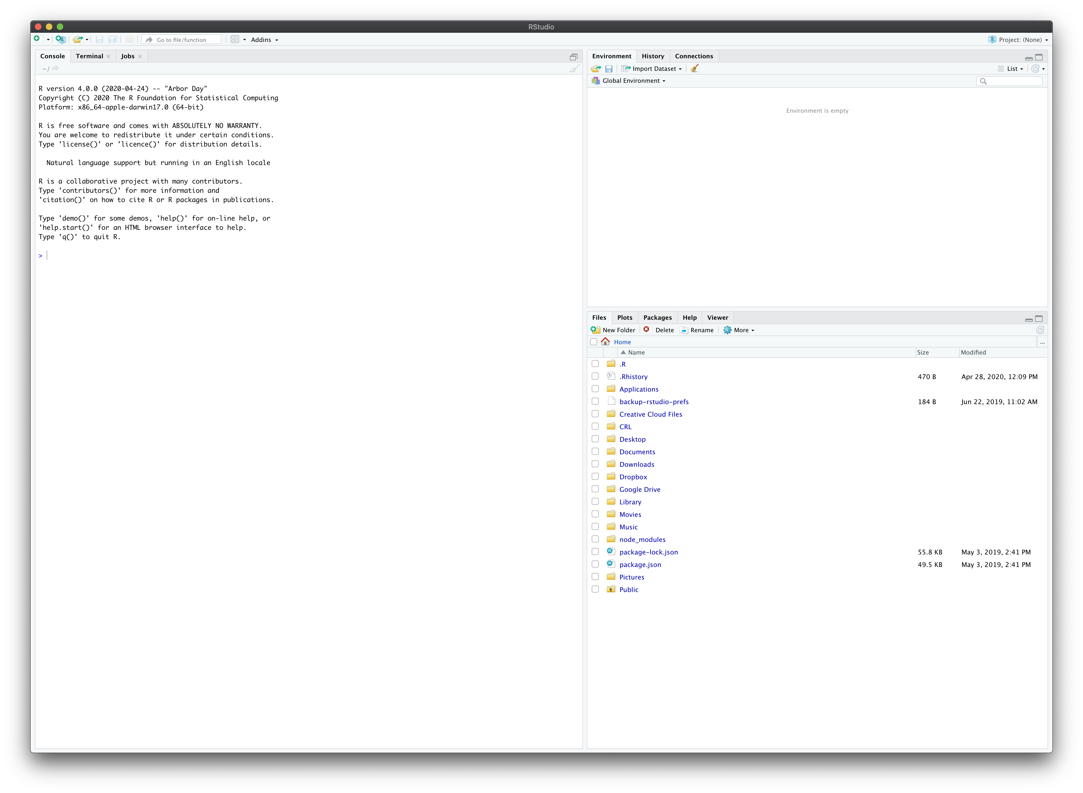
Notes:
rstudio

Slide 2
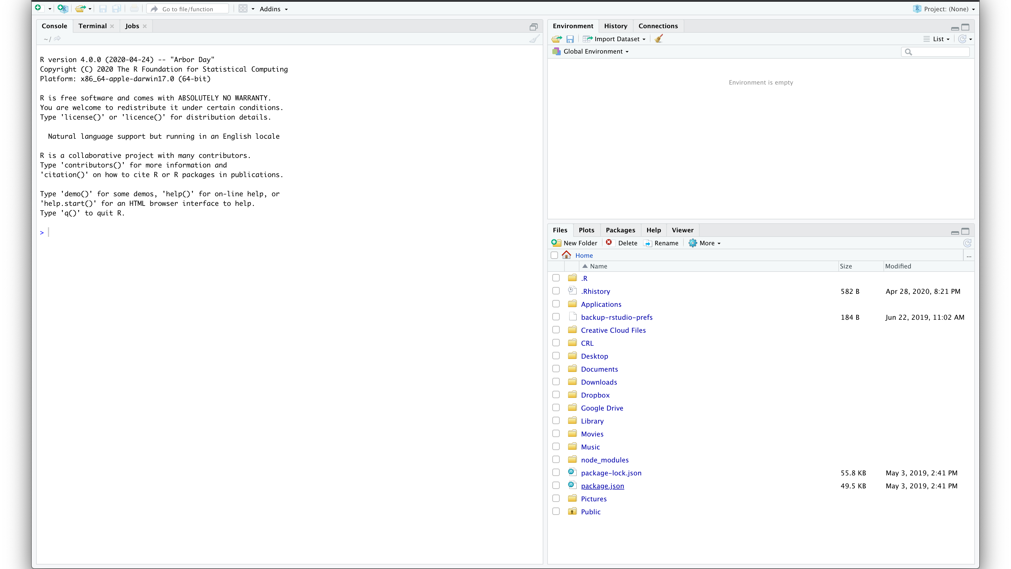
Notes:
console

Slide 3
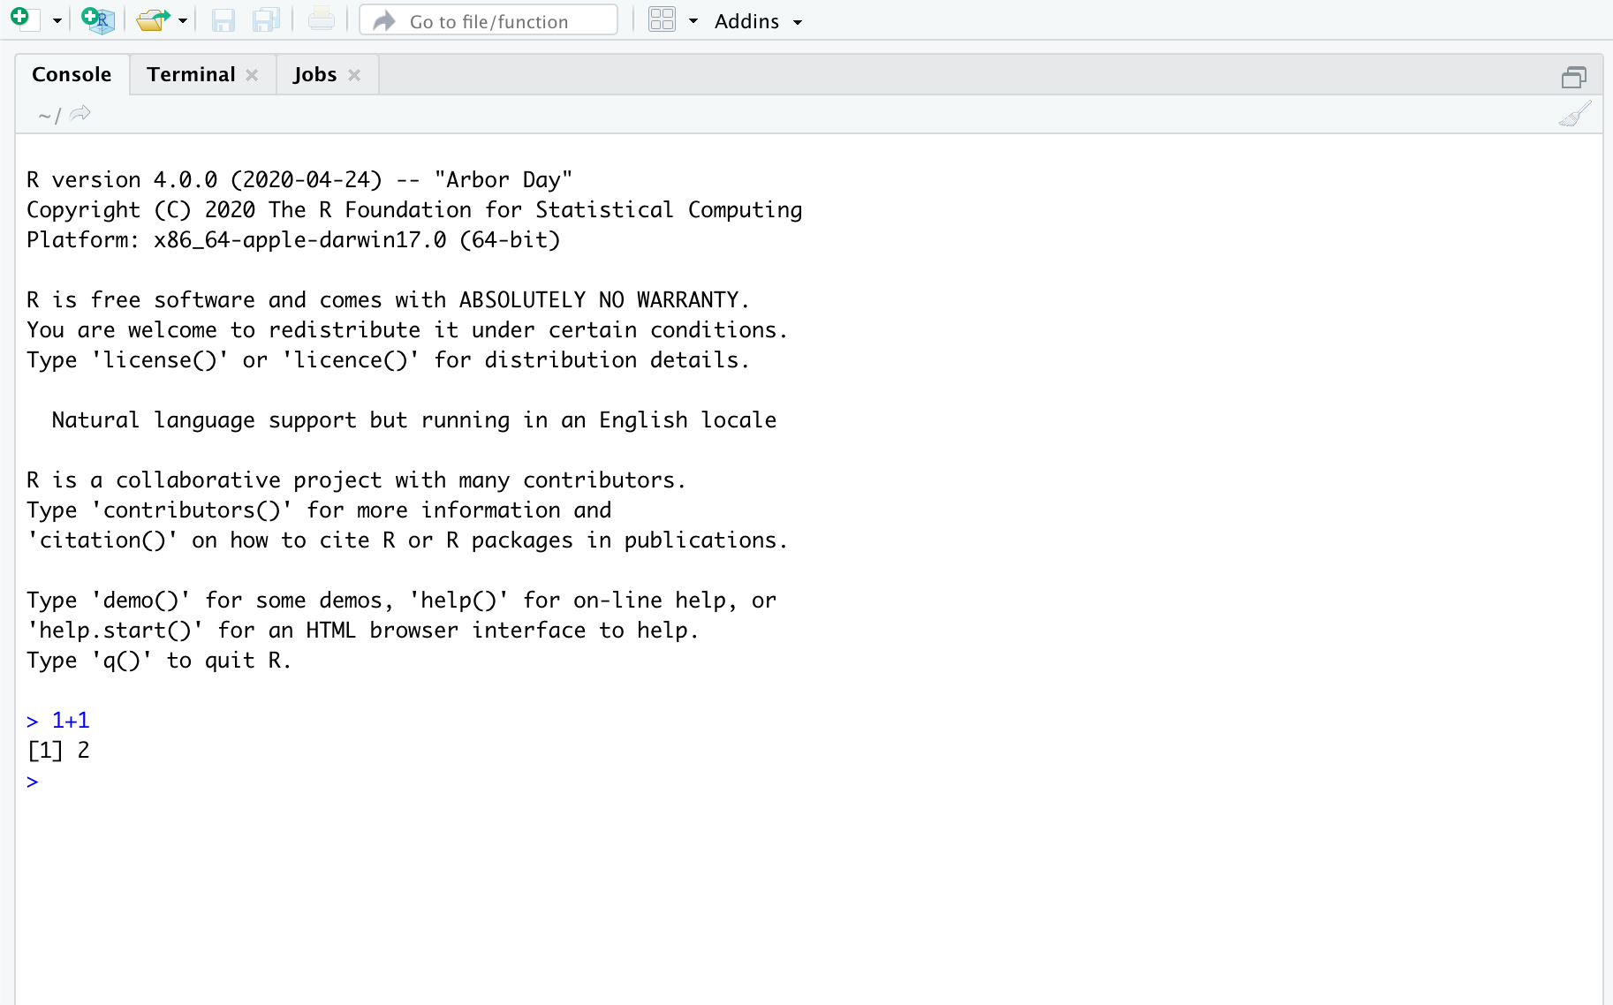
Notes:
one_plus_one

Slide 4
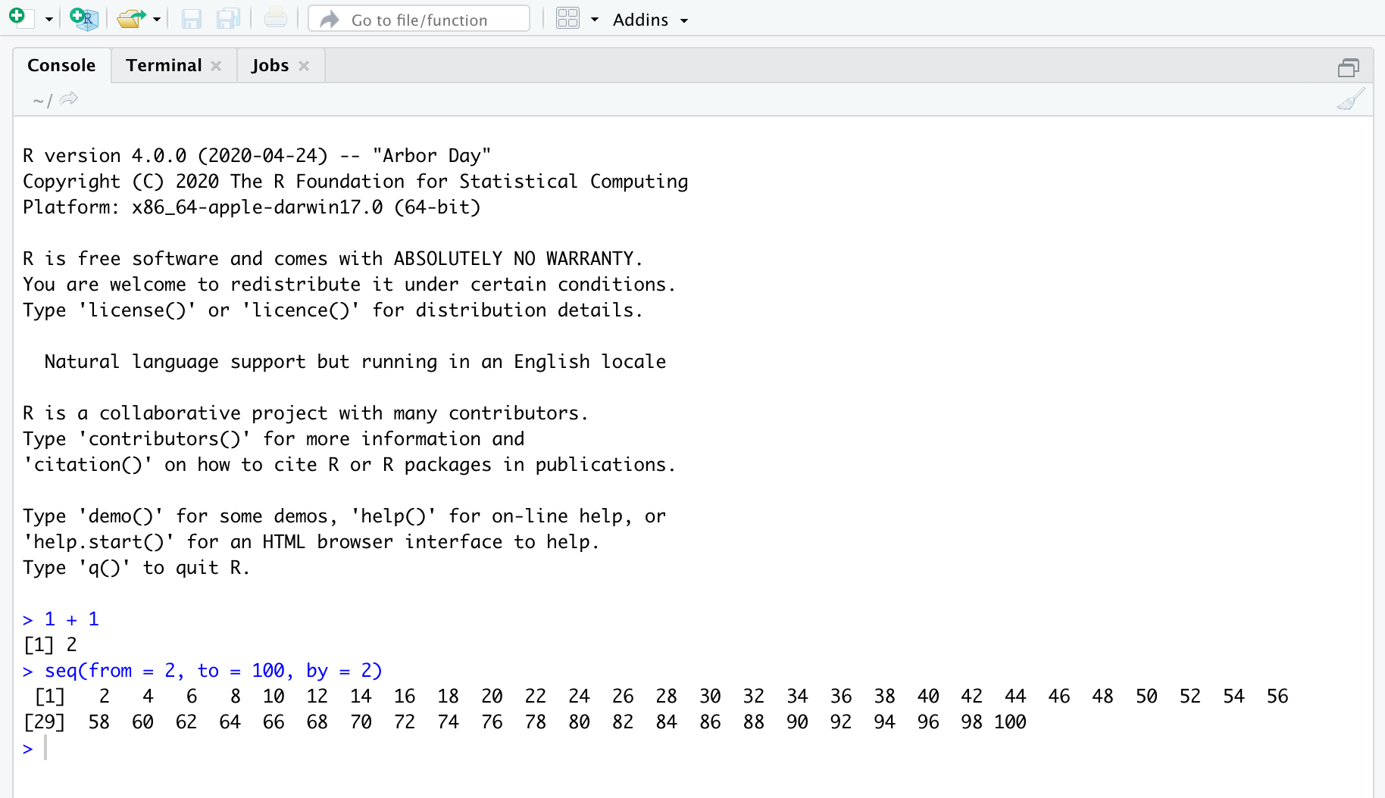
Notes:
seq_function

Slide 5
Notes:
environment_pane

Slide 6
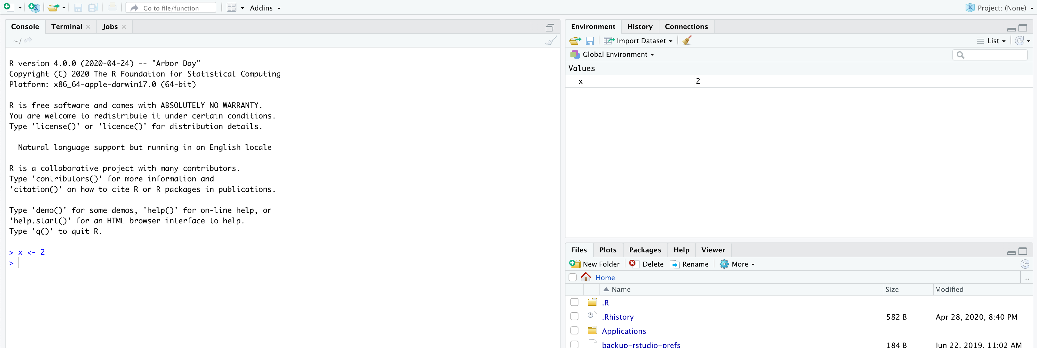
Notes:
environment_pane2

Slide 7
Notes:
files_pane

Slide 8
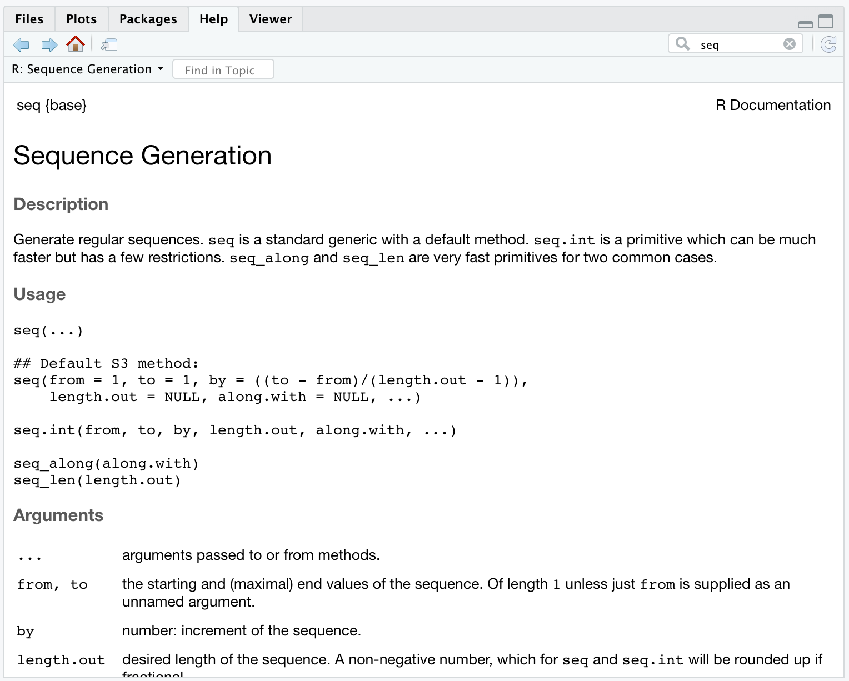
Notes:
help

Slide 9
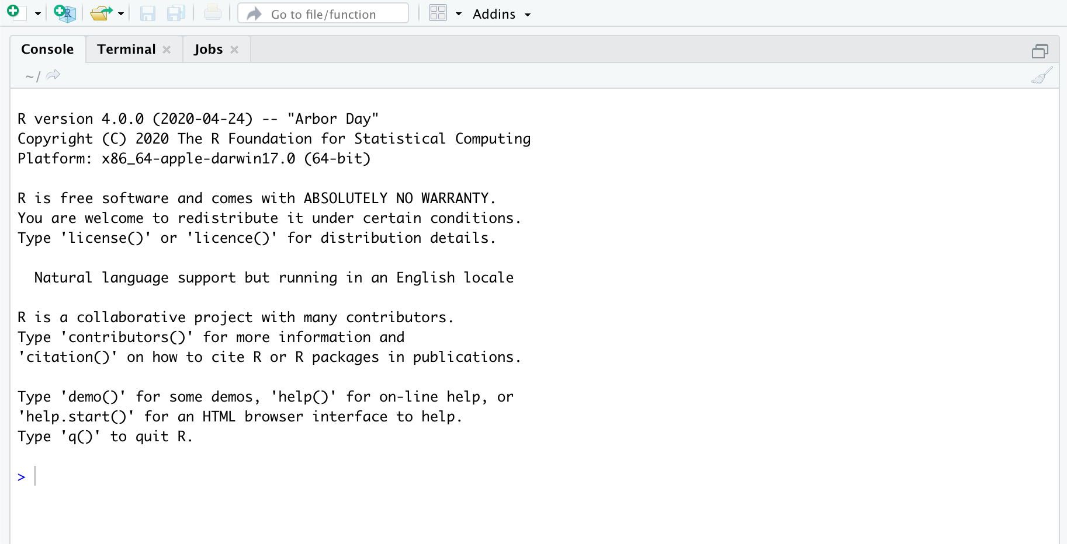
Notes:
source1

Slide 10
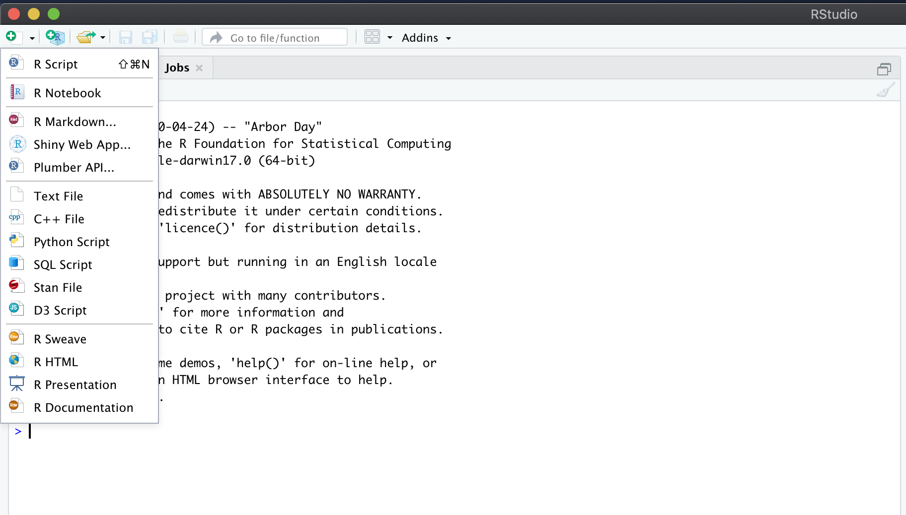
Notes:
source2

Slide 11
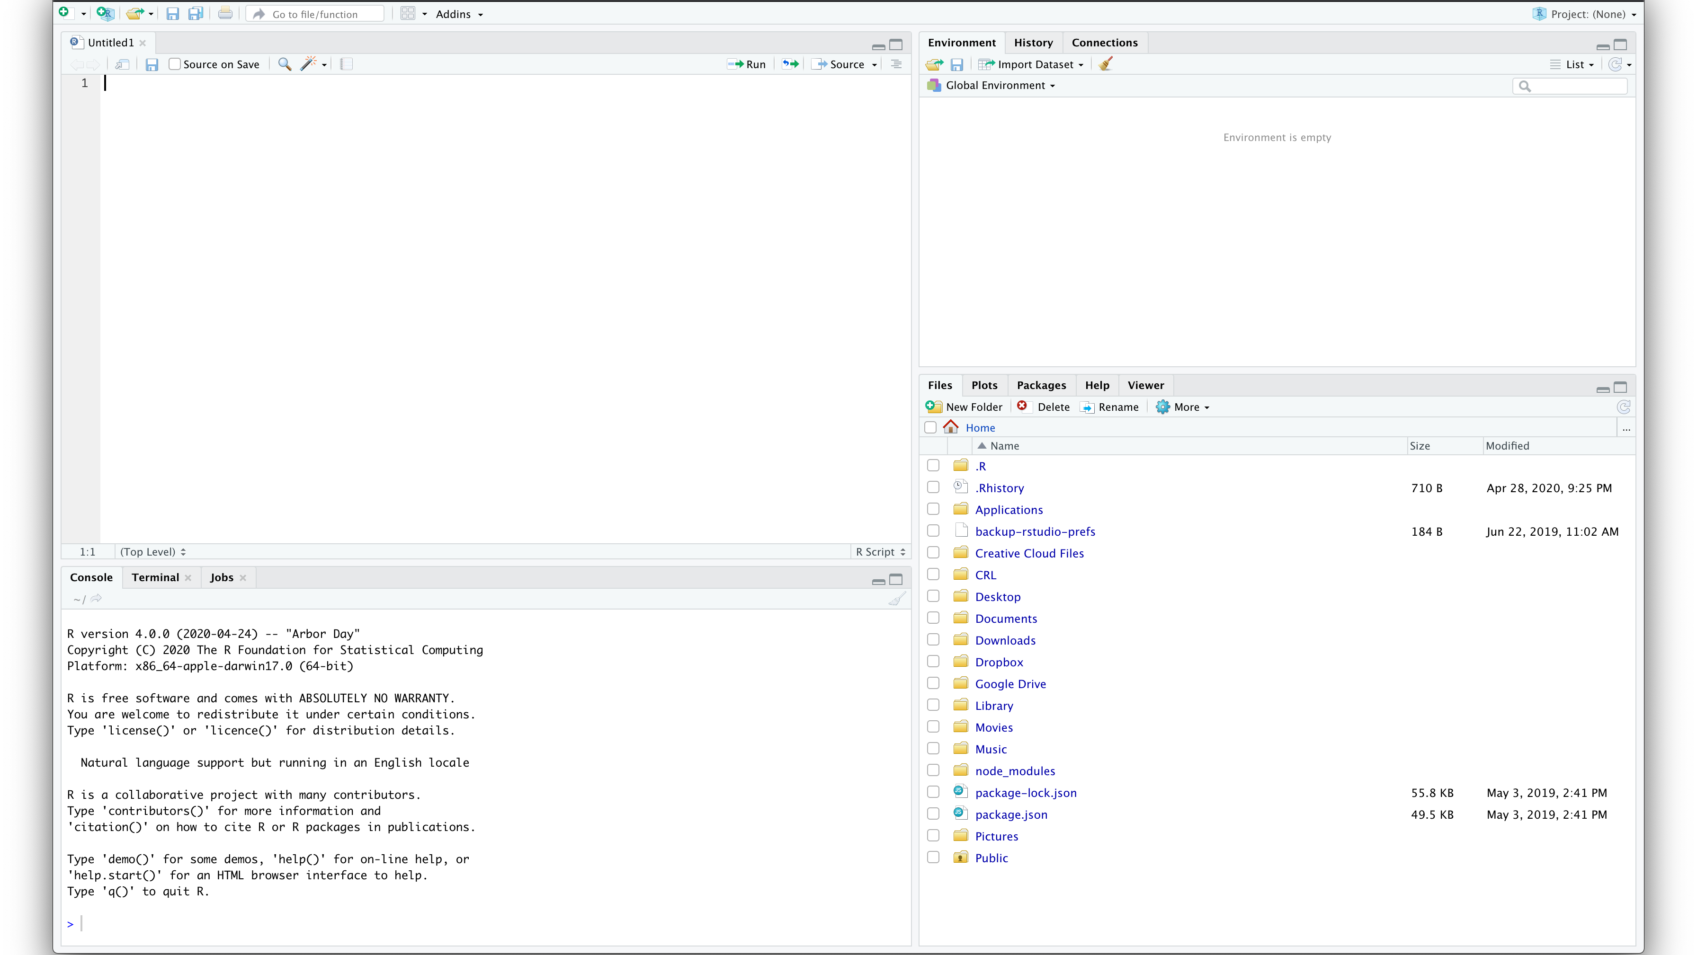
Notes:
source3

Slide 12
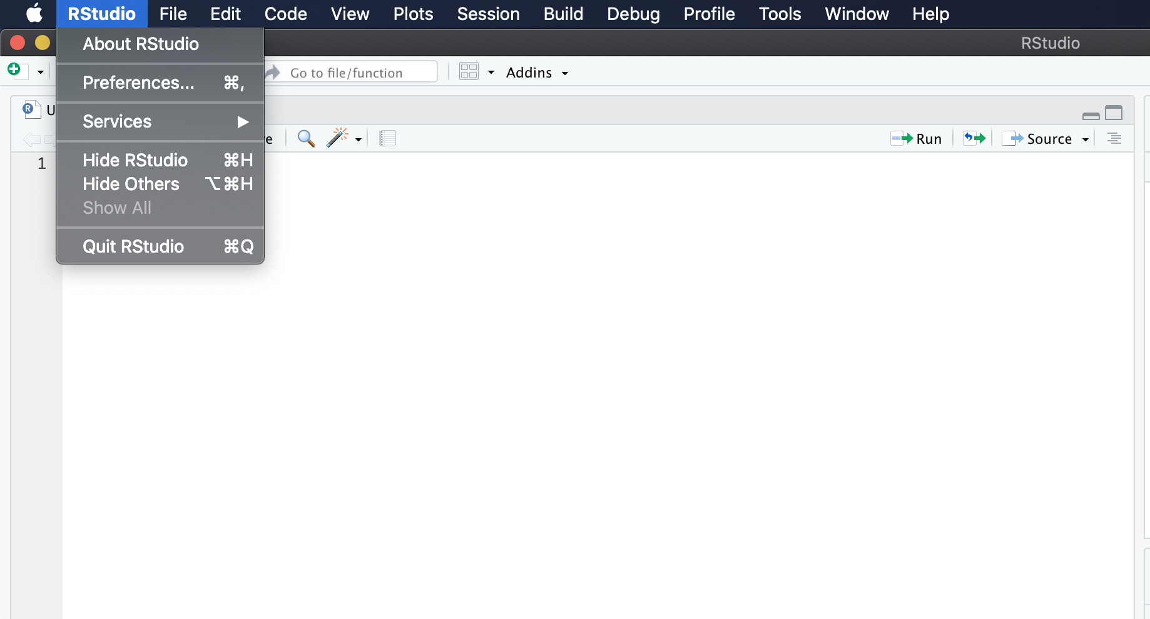
Notes:
preferences1

Slide 13
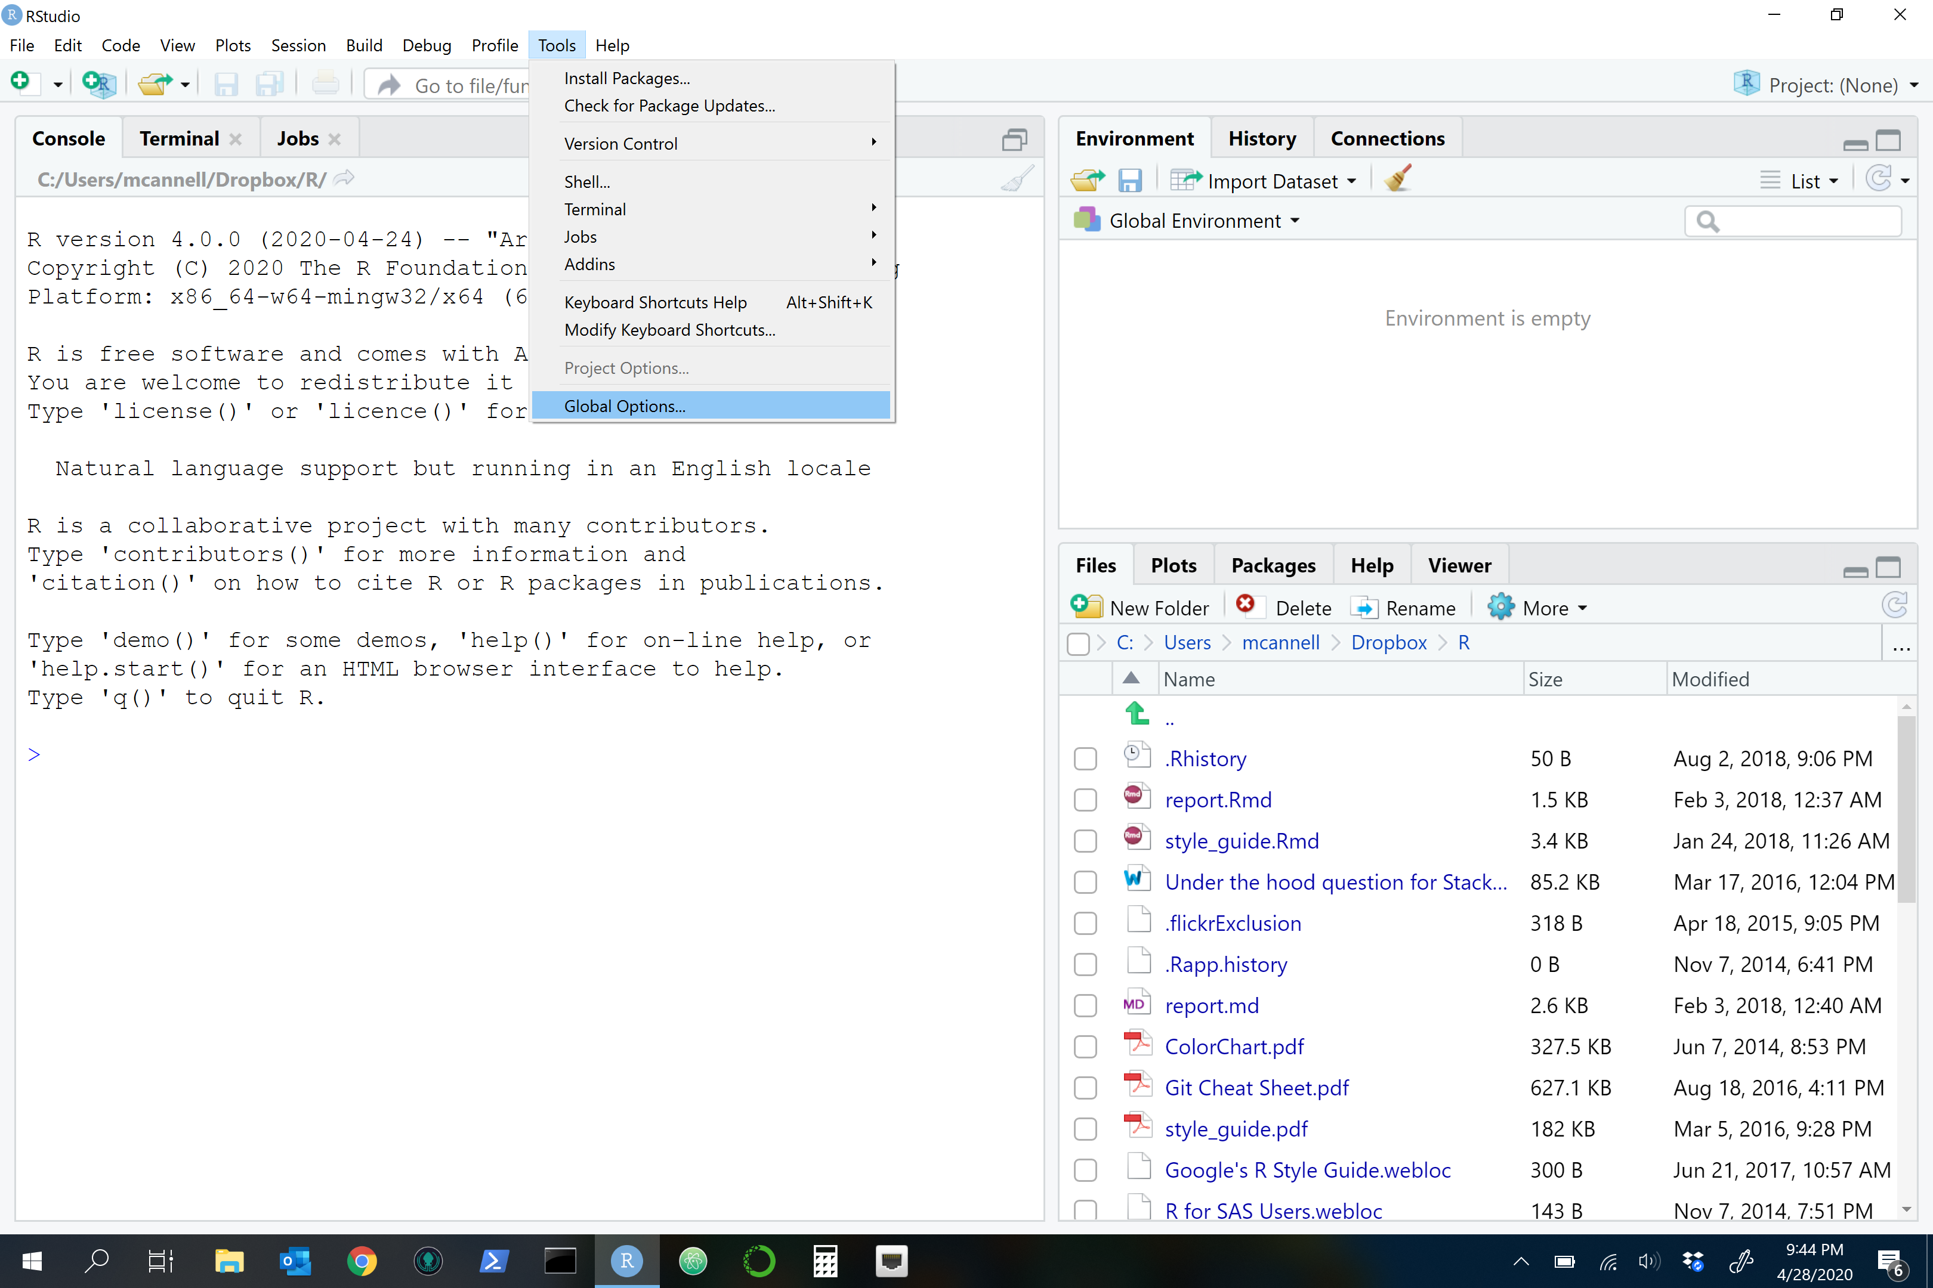
Notes:
preferences2

Slide 14
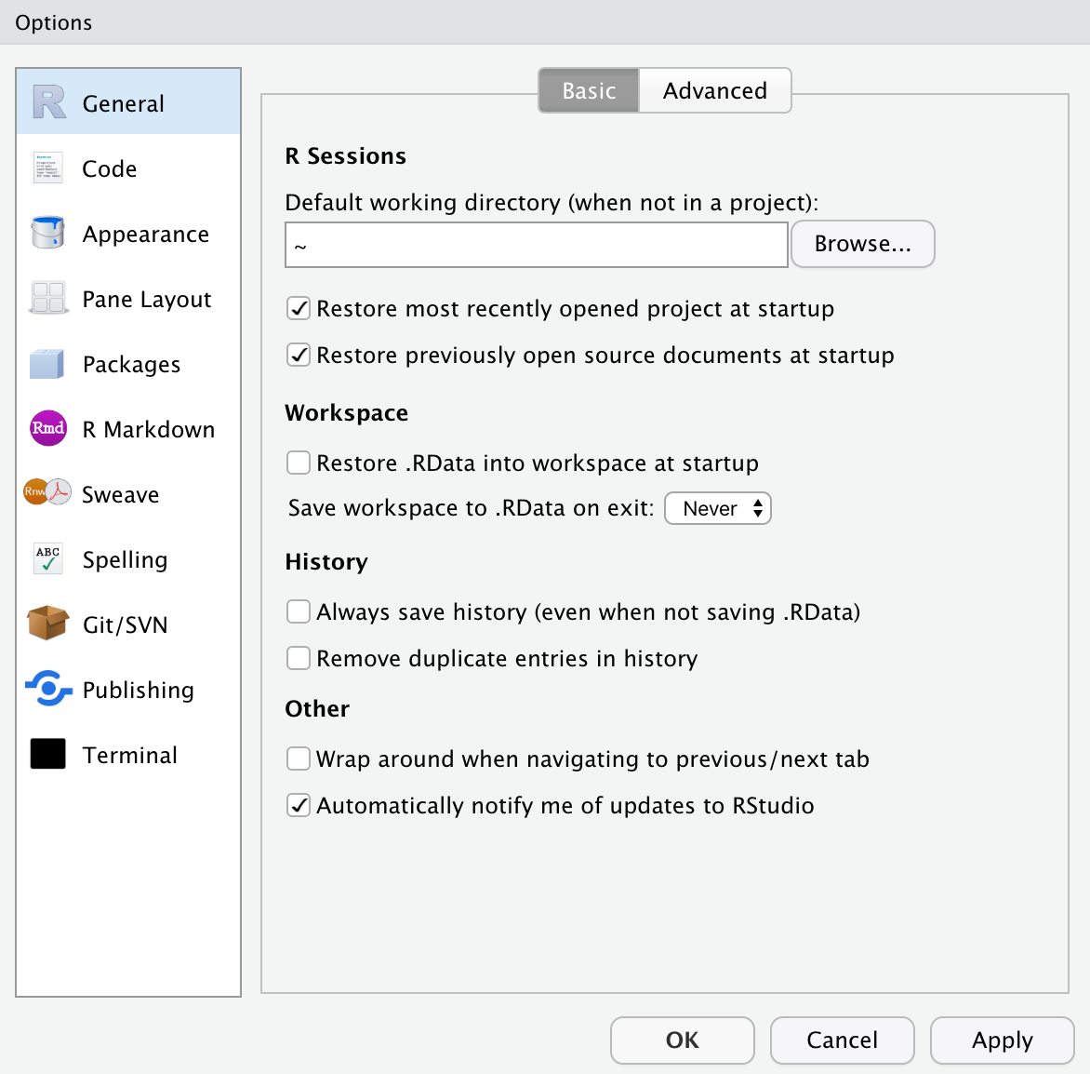
Notes:
preferences3

Slide 15
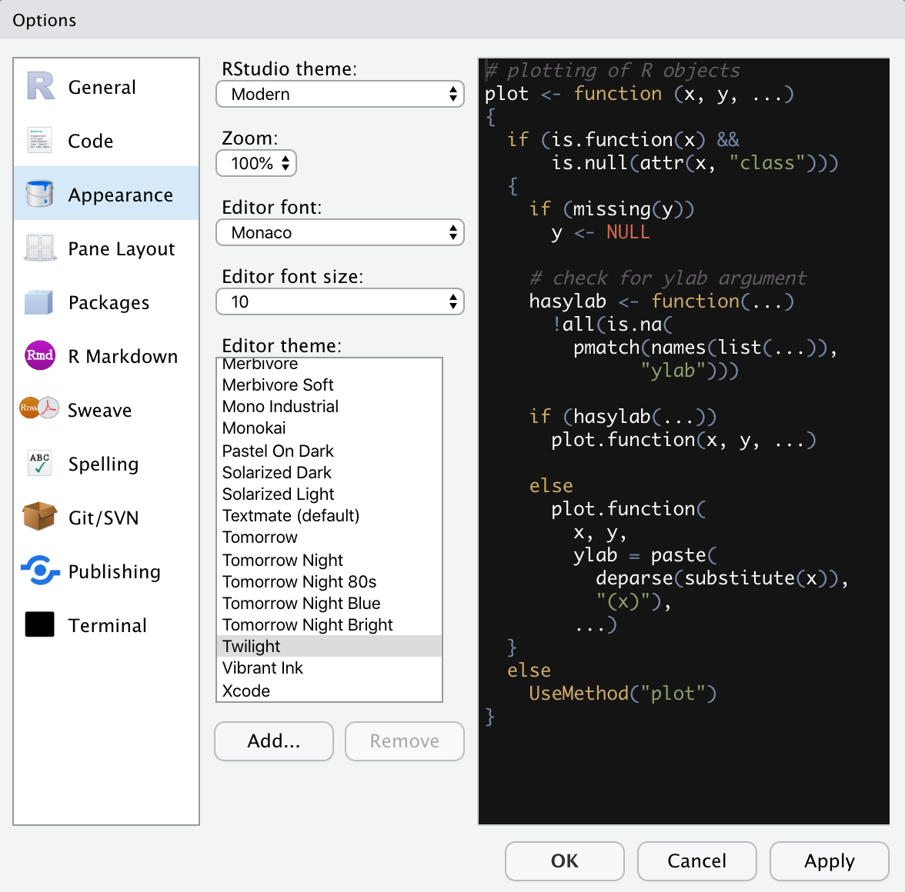
Notes:
preferences4

